Slide 1
Strategies for Divisional Application
by extracting generic concept
(Extracting generic concept from embodiment,
and “new matter” issue)
AIPLA Mid-Winter Institute (Pre-Meeting)
January 23, 2018
Attorney-at-law admitted in Japan and California
and Patent attorney
Nakamura & Partners Hideki TAKAISHI

Slide 2
“New Matter” issue
IP High Court Grand Panel Decision – Case No. 2006 (Gyo-Ke) 10563
“ … the ‘matters stated in the description or drawings’ mean technical matters derived by a person skilled in the art, putting together all statements in the specification or drawings.
If an amendment introduces no new technical matters in relation to those thus derived, the amendment can be deemed to be made within the ‘scope of the matters stated in the description or drawings.’ ”
⇒What does “an amendment introduces no new technical matters in relation to those thus derived” mean? ⇒ See the next page.
----------------------------------------------------------------------------------------------------------------------------------------------------------------------------------------------------------------------------------------------------------------------
【Examination Guidelines of JPO】
“ … if the amendment does not introduce any new technical matter in view of the ‘matters stated in the originally attached specification, etc.,’ the amendment shall be permitted. … For example, in the case where a matter to be deleted is not related to a problem to be solved by the invention and is obviously an optional additional matter from the statement in the originally attached specification, etc., the amendment does not add any new technical significance in many cases.”

Slide 3
Image of Determination Standards for New Matter
How to Determine Whether an Amendment Adds “New Matter” ?
IP High Court Grand
Panel Decision
3.3 Scope of an amendment which introduces no new technical matter
in related to the matters derived from the originally attached specification etc.
3.2 Amendment made to matters obvious from the statement in the originally attached specification, etc.
3.1 Amendment made to matters explicitly stated in the originally attached specification, etc.
3.1 “explicitly” and 3.2 “obvious” are determination standards adopted before the IP High Court Grand Panel Decision, and there are no changes before and after the said IP High Court Grand Panel Decision.
⇒ 3.3 The “scope of an amendment which introduces no new technical matter” is determined in a more flexible manner than in the case of “matters obvious from the statement in the originally attached specification, etc.”
(there are a number of court cases).

Slide 4
Summary
The IP High Court Grand Panel Decision ( = Examination Guidelines of JPO)
How to determine whether “… an amendment introduces no new technical matters in relation to those thus derived” ?
⇒For conversion into generic concept, the relationship between the matters amended and the problem to be solved by the invention is important !!
⇒ Not judged by tangible/concrete disclosure in a specification.
⇒ The same applies in the case where an amendment for restricting the
claims is made by generalizing a working example!!
Amended/Divisional
claim
previous claim 2
previous claim 1
Amendment
to seek
Inventive step
Divisional Application
to broaden the right
After patented
Embodiment explicitly shown in the specification.

Slide 5
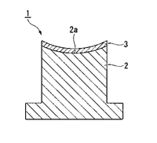
Examination Guideline of JPO – Sample Case
Case 7: Conversion into Generic Concept ~ Amendment for deleting a Claim Language 【Amendment OK】
Claim before Amendment “… a concave molding surface”
Claim after Amendment “… a concave molding surface”
⇒After the amendment, both of a “concave molding surface” and a “convex molding surface” are included in the claimed invention.
[Explanation] The problem to be solved by the invention of the present application is to provide a mold for optical elements with superior mold release properties and durability under high temperature by improving the coating membrane coating the surface of the molds for optical elements, and the shape of the molding surface of the mold for optical elements is not directly relevant to the solution of the problem. Therefore, the shape of the molding surface of the mold is not deemed an indispensable factor as a mean for solving the above problem and is a optional additional factor for the claimed invention and does not introduce any new technical matter.
<Note> It makes no sense to make an amendment which converts the matters specifying the invention into more specific concepts based on the foregoing logic, because the invention will be lack of inventive step in the end.
⇒The foregoing logic is useful in the case of making an amendment which converts the matters specifying the invention into generic concept and expand the technical scope of the invention!!
⇒The point is whether or not the matters amended or corrected are (directly) relevant
to the solution of the problem to be solved by the invention!!

Slide 6
Examination Guideline of JPO – Other Sample Cases
Case 2 Slip printing system Conversion into generic concept, deletion or change ×
After the amendment, printing information which was printed until the paper out occurs may be or may not be reprinted.
⇒ Both cases have to be contained in the description.
⇒ If one or more matters are conceivable which are not described in the claims after the amendment, every matters need to be disclosed in the description.
Case 15 Printer Conversion into more specific concept or addition ×
The claim after the amendment is too broad.
It is unclear from the drawing whether the interrupt job is registered to be printed before or after the previous interrupt job.
⇒ In either cases, the amendment is not admitted.
⇒ If one or more matters are conceivable which are not described in the claims after the amendment, every matters are need to be disclosed in the description.
Case 6 Method for producing steroid Conversion into generic concept, deletion or change ○
Case 14 Post-driving device Conversion into more specific concept or addition ○
After the amendment, the amended claimed invention comprises only the first step. (The amendment is found not fall under the addition of a new matter, because the first step is stated in the originally attached description. However, it may be another question whether it is possible to extract only the first step.)
⇒ The originally attached description mentions a method of production comprising several steps. This is an amendment case of claiming only a part of the production steps.
Case 12 Amusement machine using elastic balls Conversion into more specific concept or addition ×
⇒ The originally attached description mentions the specific function of the first lamps, but does not mention any function of the second lamps. In such a case, the amendment that adds “that have different functions” is found to be unlawful.
⇒ If different functions of the first lamps and second lamps are specifically described in the originally attached description, is an amendment that adds abstract expression “that have different functions” found to be lawful?
Case 20 Thermoplastic resin composition Conversion into more specific concept or addition ×
⇒ “polyester, polyamide, and the like” are only described as examples of “thermoplastic resins”, and conversion into generic concept is not permitted.
⇒ This is an amendment case of integrating and abstracting several specific examples.
Case 22 Sweet bean paste Conversion into more specific concept or addition ×
⇒ Although there is the expression “preventing the paste from freezing under refrigeration”, the amendment for changing “a sweet bean paste” into “a sweet bean paste for ice cream” is not permitted.
⇒ This is a case in which an amendment that adds “for (use in) ~” came into question.
Case 23 Cosmetic product Conversion into more specific concept or addition ○
⇒ Taking a common general knowledge into consideration, the amendment that is made by combining plural examples (combined use of plural compounds) is permitted.

Slide 7
Examination Guideline of JPO – Other Sample Cases
Case 24 Rolling method Conversion into more specific concept or addition ○
⇒ the amendment for changing “same as or smaller than” into “smaller than” is permitted.
(No technical meaning is recognized in light of the maintenance of the effect.)
★ Case 25 Mobile phone terminal Conversion into more specific concept or addition ○
★ Case 26 Intercom device Conversion into more specific concept or addition ○
Case 19 Device for opening a fertilizer bag Conversion into more specific concept or addition ○
⇒ The amendment that adds “a function to convert acoustic signal to audio electrical signal, and a function to convert audio electrical signal to acoustic signal” is permitted because “music reproduction function” is described in the originally attached description (Case 25).
⇒ The amendment for changing “detect human body” of claims into “detect human body without contacting” is permitted because the detection of human body by a “camera” is described in the originally attached description. (Case 26)
⇒ The amendment which converts the matters stated in the originally attached description into generic concept is permitted. (Cf. Case 55)
⇒ The amendment for claiming a part of mechanical structure described in the originally attached description is found to be lawful. (Case 19)
(There is no specific reason to consider that the originally attached description only mentions …)
Case 28 Method of drying unhulled rice using an infrared ray Numerical limitaion ×
⇒ The amendment based on a graph is found to be unlawful.
Case 31 Adhesive agent for temporary adhesion Numerical limitation ○
⇒ The amendment based on Table is found to be lawful.
(※ Is it permitted to claim “9.5” as a matter of course? Is it permitted to claim any numbers?)
Case 30 Hollow microsphere Numerical limitation ○
⇒ The amendment that changes the numerical range of “200-10000” in a claim into “200-6000” in accordance with the numerical range of “500-6000” described in the originally attached description is permitted.
⇒ This is a case in which an amendment that claims either the upper value or the lower value of the numerical range is permitted.
Case 32 Photosensitive plate for planography Excluding claim ○
Case 33 Photosensitive composition Excluding claim ○
⇒ An ordinary “excluding claim” case. It is believed to be undue to explain that “… inventions that basically have an inventive step, but happen to have an overlap with a cited invention”. (Case 32)
⇒ An excluded part has to be clarified. (Case 33)

Slide 8
Examination Guideline of JPO – Other Sample Cases
Case 35 Phosphane derivatives Markush form ○/×
⇒ Specific examples need to be provided when part of alternatives are removed respectively from two chemical substance groups (combinations of compounds).
Opposite Cases
Case 36 Cyclobutanedione compounds Markush form ○
Case 37 Substituted benzyl alcohol Markush form ○
⇒ Specific examples do not need to be provided when one of the alternatives (compounds) is removed.
(Is it consistent with Case 35 if the division or amendment is carried out in two stages?)
Case 38 Phosphane derivative Markush form ○
⇒ A technical term used in claims usually does not encompass chemical substances stated in claims amended, however, an amendment is broadly admitted in accordance with the definition in the description.
(A technical term may be interpreted as defined in the description.)
Case 47 Device for reading figures in using an abacus Resolution of mismatch description ○
⇒Correction of an error is admitted. (“about 130 degrees” ⇒ “about 110 degrees”)
Case 48 Method for synthesizing graphene Clarification of ambiguous description ○
⇒In consideration of the common general knowledge of those skilled in the art, the amendment for changing “%” to “% by mass” is admitted. (Clarity)
Case 50 Shock absorber Addition of example ×
Case 57 Malfunction-prevention switch Amendment based on disclosure in drawing ×
⇒ The amendment of claim made by abstracting the drawings is not permitted. (⇔Case 25, 26)
Case 55 Heat treatment device Amendment based on disclosure in drawing ○
⇒ Taking the descriptions into consideration, the amendment of claim made by abstracting the drawings is permitted (＝Cases 25, 26)

Slide 9
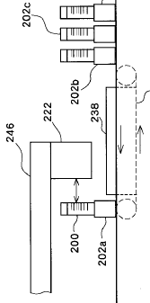
Court Cases which focused “the problem to be sold by the Invention” ①
“Rack Conveying Apparatus” Case – The IP High Court Case No. 2015 (Gyo-Ke) 10087
(The manner of attaching the measuring unit) “hanging” ⇒ “holding”
[Amendment OK] (Conversion into generic concept)
(Excerpts from the Decision)
“… it may be said that any person ordinarily skilled in the art
who reads those statements would understand that the manner
of attaching the measuring unit to the movable arm is not the
fundamental matter of the Invention and it would suffice if the
measuring unit is held by a movable arm in a manner that allows the
measuring unit to perform its functions. If the common general technical knowledge as of the time of the filing of the patent application is taken into consideration, it was obvious from the statements contained in the specification that the manner of attaching the measuring unit to the movable arm could be changed from ‘hanging’ to any other method such as ‘embedding.’ …
Further, even if specific differences occur for functional effect between the manner in which the arm is holding the measuring unit and the manner in which the arm is hanging the measuring unit, the foregoing is not directly relevant to the technical meaning of Invention 7 described in the specification, and considering the common general technical knowledges as of the time of the filing the patent application, it does not affect the finding that Corrected Invention 2 is obvious from the statements contained in the specification.”
This is a typical case showing the tendency of the courts to easily admit an amendment in the case where an amended matter is not essential (a necessary element) in relation to the problem to be solved by the invention, even if the matter is not explicitly stated in the originally specification.
Measuring
Unit
Movable Arm

Slide 10
Court Cases which focused “the problem to be sold by the Invention” ②
“Light-emitting Diode” Case (1) – The Tokyo District Court Case No. 2011 (Wa) 32776
(A light-emitting device consisting of a gallium nitride based compound semiconductor)
⇒A limitation of chemical formula “Ga_{x}AI_{1-x}N (0≦X≦1)” is removed.
[Amendment OK] (Conversion into generic concept)
(Excerpts from the Decision)
“In light of the statements … in the originally attached specification, the problem to be solved by and means for solving the problem of OTSU-1 Invention is reasonably understood to emit visible light of a wavelength longer than a wavelength of a light emitting device from a fluorescent dye or a fluorescent pigment, to change the light of wavelength from the light emitting device, and to improve spectral luminous efficacy of the light emitting diode by adding a fluorescent dye or a fluorescent pigment in a resin molding which surrounds the light emitting device consisting of a gallium nitride based compound semiconductor. …
Hence, it is understood that with respect to ‘a light-emitting device consisting of a gallium nitride based compound semiconductor’, a person skilled in the art can understand a problem and means for solving the problem which are common to those of OTSU-1 Invention itself in light of the statement in the originally attached specification. Therefore, … the originally attached specification discloses the invention which comprises a light-emitting device consisting of a gallium nitride based compound semiconductor (without the present composition and limitation on a light emission peak) surrounded by a resin molding to which a fluorescent dye and a fluorescent pigment that produce fluorescent excited by light from the gallium nitride based compound semiconductor light emitting device are added.”
An amendment is admitted to the extent the matters disclosed in the original specification can be understood to be common to the problem to be solved by the invention and means for solving the problem.

Slide 11
Court Cases which focused “the problem to be sold by the Invention” ③
“Light-emitting Diode” Case (2) - The Tokyo District Court Case No. 2011 (Wa) 35168
⇒A limitation of chemical formula is removed.
(*Amendment is just the same as the previous “Light-emitting Diode” Case (1))
[Amendment ×] (Conversion into generic concept)
(Excerpts from the IP High Court Decision)
“… It is natural for a person ordinarily skilled in the art to learn and understand the specification in B5 that ‘(when adopting the base structure,) deterioration due to moisture could be prevented’ mentions a fluorescent substance with the composition in question. Also, … it is natural for a person ordinarily skilled in the art to learn and understand that properties of the fluorescent substance with the composition in question make it possible to adopt the base structure (and prevent deterioration due to moisture when adopting the base structure). … it cannot be said that a person ordinarily skilled in the art who has accessed 【0047】 could have also understood that it would be possible to adopt the base structure described at 【0047】 with regard to a fluorescent substance that did not have the composition in question. …”
The keyword “problems to be solved by the invention” is not used in the decision.
The court addresses, as an issue, the scope which a person ordinarily skilled in the art can recognize and understand that the invention has “effects” based on the statement of the originally attached specification.

Slide 12
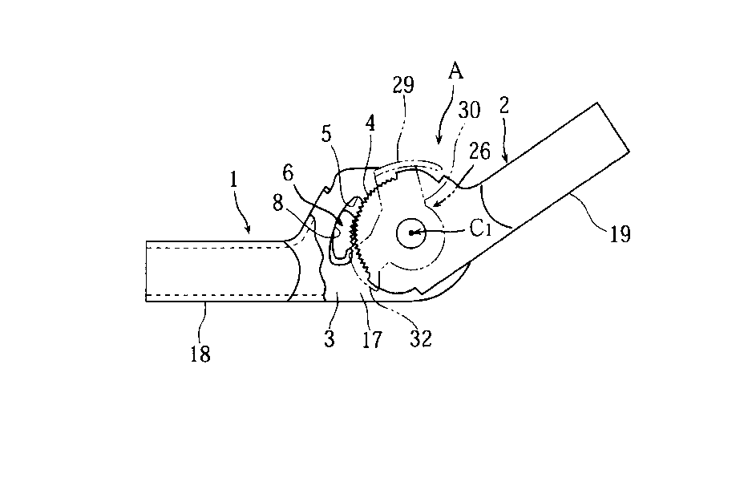
Court Cases which focused “the problem to be sold by the Invention” ④
“Angle Adjust Metal Fittings” Case – The IP High Court Case No. (Ne) 10098
※ Amendment ×:
“a wedge face of a wedge-shaped window part” ⇒ “a wedge face which forms a wedge-shaped space part” (Conversion into generic concept ~ the component “a wedge-shaped window part” is removed.
(Excerpts from the Decision)
“… there is no description or suggestion about components other than
the component that ‘a wedge face’ … ‘which is formed on the outer
side by a wedge-shaped window part on the first arm’ …”
Hence, it cannot be said that a person ordinarily skilled in the art
who has accessed the original specification could have understood
that the problem to be solved by the invention can be solved by forming
a wedge face, on which an abutting surface of a floating wedge component
abuts, by different components or members, without forming a wedge-shaped window part in a case part of the first arm, and could have also expected structures to solve the problem. … It is
understood that the present patented invention includes not only an embodiment in which a wedge face is formed by forming a wedge-shaped window part in a case part of the first arm, but also an embodiment in which a wedge face is formed by different members without forming a wedge-shaped window part on the first arm; and therefore, the amendment is considered to convert the technical matters disclosed in the original specification into generic concept. It cannot be said that the technical matters converted into generic concept are described in the original specification in a practical way.”
(Consideration) The amendment is found to add new matters because a person skilled in the art cannot understand from the original specification how to solve the problem to be solved by the invention without forming “a wedge-shaped window part”.
Floating Wedge Component 6
浮動くさび
部材６
くさび面８
Wedge Face 8
くさび形
窓部５
Wedge-shaped window part 5

Slide 13
Summary (AGAIN)
The IP High Court Grand Panel Decision ( = Examination Guidelines of JPO)
How to determine whether “… an amendment introduces no new technical matters in relation to those thus derived” ?
⇒For conversion into generic concept, the relationship between the matters amended and the problem to be solved by the invention is important !!
⇒ Not judged by tangible/concrete disclosure in a specification.
⇒ The same applies in the case where an amendment for restricting the
claims is made by generalizing a working example!!
Amended/Divisional
claim
previous claim 2
previous claim 1
Amendment
to seek
Inventive step
Divisional Application
to broaden the right
After patented
Embodiment explicitly shown in the specification.

Slide 14
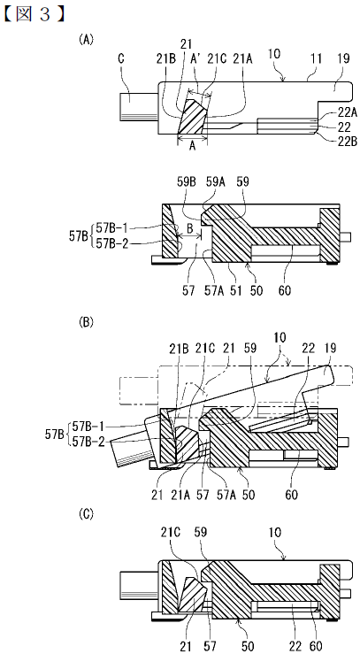
Amendment for restricting the claim by generalizing embodiments
Cf.H28.10.19 “Electric Connector Assembly” Case – Case No. 2016 (Ne) 10047 (Patent infringement・accepted)
(【Fig.3】, 【 Fig.7】common) <JP5362931>
<Structure of the Invention after the correction>
・ There are no limitation on the dimensional relation
between the locking protruding portion and the locking
groove portion (shown in the blue circles) ⇒ A > B > A’
・ The locking protruding portion is located at the outer side
of the rising portion when is in an inclined state during
the fitting (as shown in Fig. (B)).
・ The locking protruding portion moves to the inner side of the
rising portion when it is in the state of completion of the fitting
(as shown in Fig. (C)).
<Effects of the Invention after the correction>
After completion of the fitting of a cable connector (the
upper drawing in Fig. 3(A)) to a receptacle connector
(the lower drawing in Fig. 3 (A)) as shown in Fig. 3 (C),
the coming off of the cable connector can be prevented
with the interference between the locking protruding
portion and the rising portion even if some force is
applied upward onto a cable C (in the red-arrow marked
direction).
Locking protruding portion
Rising portion
13

Slide 15
Other issues under the Patent Act and “the problem to be solved by the invention” ①
Inventive Step (Article 29, Paragraph 2 of the Patent Act)
With respect to a rationale for negating an inventive step of the claimed invention because of motivation for applying secondary prior art to primary prior art, similarity of problems to be solved between the primary prior art and the secondary prior art will be an issue, and if there are similarity between them, motivation will easily be recognized.

Slide 16
Other issues under the Patent Act and “the problem to be solved by the invention” ②
Support Requirement (Article 36, Paragraph 6, Item 1 of the Patent Act)
“Medicine” Case – The IP High Court Case No. 2011 (Gyo-Ke) 10147
⇒ As general standards of judgment with regard to support requirement, the court found as follows (the courts found the same effect in Case No. 2012 (Gyo-Ke) 10299, Case No. 2011 (Gyo-Ke) 10235):
[Said standards of judgment is widely accepted, and it is obvious that whether the support requirement is satisfied or not is closely related to the problem to be solved by the invention.]
“ … Whether the statement in the claims satisfies the support requirement should be determined by considering, through comparison of the statement of the scope of claims and the statement of the detailed explanation of the invention, whether the invention described in the scope of claims is the invention described in the detailed explanation of the invention that is within the scope for which a person ordinarily skilled in the art can recognize, based on the statement of the detailed explanation of the invention, that the invention can solve the problem to be solved by the invention, and also by considering whether the invention described in the scope of claims is an invention within the scope which a person ordinarily skilled in the art can recognize, in light of the common general knowledge as of the time of filing the application, that the invention can solve the problem to be solved by the invention, even without the statement and indication thereof. …”

Slide 17
Other issues under the Patent Act and “the problem to be solved by the invention” ③
Enablement Requirement (Article 36, Paragraph 4 of the Patent Act)
“Assembling Block Device” Case – The IP High Court Case No. 2008 (Gyo-Ke) 10199
“The Plaintiff argues that … various assembling block devices can be created from the structure of the present invention based on empirical rules or common general knowledge. However, … as the detailed explanation of the invention in the description contains no guide to determining a specific structure which forms the basis of means for solving the problem targeted by the present invention, a person skilled in the art has to exercise its own creativity in embodying them. Therefore, it cannot be said that the statements in the description satisfy the enablement requirement.”

Slide 18
Other issues under the Patent Act and “the problem to be solved by the invention” ④
Clarity Requirement (Article 36, Paragraph 6, Item 2 of the Patent Act)
・ “Removable Device” Case – The IP High Court Case No. 2007 (Gyo-Ke) 10403
⇒The satisfaction of the clarity requirement is determined on the basis of whether or not the “element necessary for solving the technical problem to be solved by the invention are recited in the claim”.
・“A method of stirring and defoaming solvent, etc. and equipment therefor” Case – The IP High Court Case No. 2009 (Gyo-Ke) 10329
⇒The satisfaction of the clarity requirement is determined on the basis of whether or not the “structure for achievement of the problem would be ambiguous”.
・ “Face-bow” Case – The IP High Court Case No. 2011 (Gyo-Ke) 10097
⇒ The satisfaction of the clarity requirement is determined on the basis of whether or not “means for solving the problem is recited …”.

Slide 19
Other issues under the Patent Act and “the problem to be solved by the invention” ⑤
The Doctrine of Equivalents (the first requirement)
The IP High Court Grand Panel Decision rendered on March 25, 2016 (Case No. 2015 (Ne) 10014)
“… the essential part of a patented invention should be understood as the characteristic part which constitutes a unique technical idea that is not seen in prior art in the statements in the scope of claims of the patented invention.
The aforementioned essential part should be found by first understanding the problem to be solved and means for solving the problem by the patented invention … and its effect … based on the statements in the scope of claims and the specification, and then determining the characteristic part which constitutes a unique technical idea that is not seen in prior art in the statements in the scope of claims of the patented invention.”
Indirect Infringement (Article 101, Item 2, Item 5 of the Patent Act)
“Where a patent has been granted for an invention of a product, acts of producing, assigning, etc., importing or offering for assignment, etc. any product (excluding those widely distributed within Japan) to be used for the producing of the said product and indispensable for the resolution of the problem by the said invention as a business, knowing that the said invention is a patented invention and the said product is used for the working of the invention.” (Item 2)

Slide 20
Thank you！!
Hideki Takaishi
AIPPI JAPAN
NAKAMURA & PARTNERS
TEL: 81-3-3211-3437（Direct）
E-mail : h_takaishi@nakapat.gr.jp

