Slide 1

Use Claim Strategies for Japan
Writing, Litigation, and
Other Techniques for Success
(writing)
Nakamura & Partners
Hironobu Hattori
Japanese Patent Attorney

Slide 2

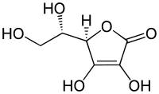
What is Use Claim?
Use Claim
= A product claim which has a limitation of the specific use of the product.
Even if the product is known, the product is patentable if the intended use of the product is novel.
Used for ...
anti-oxidant
Anti-cancer
Vitamin C
=
?
Ascorbic acid
Even if L-ascorbic acid is known, the intended use of it is not known, the intended use is considered a limitation of a claimed invention.
Other allowable examples:
Fe based alloy for a piano string having composition A.
Composition for use in anti-fouling ship bottoms comprising compound B.
A hook for crane with a shape of …
http://www.picserver.org/images/highway/phrases/antioxidant.jpg

Slide 3


What is Use Claim?
Vitamin C is newly found, used as an anti-oxidant
Both are
Patentable.
20 years
Claim 1: L-ascorbic acid (vitamin C).
X pharma
An anti-virus activity of C is newly found
20 years
Claim 1: Anti-virus agent comprising
L-ascorbic acid (vitamin C).
Y pharma
X needs to have a license on Vitamin C as anti-virus from Y.
Y needs to have a license on Vitamin C from X.
Patent term is substantially extended, but it is important to
Give an incentive to develop an anti-virus agent using vitamin C.
=
No patent
No cure

Slide 4



Vitamin C
What is known ?
What is claimed ?
No prior art, vitamin C is unknown
Vitamin C.
Vitamin C as an anti-oxidant is known
Medicament comprising vitamin C.
(1st medical use)
Vitamin C as an anti-virus is known
Anti-cancer drug comprising vitamin C.
(2nd medical use)
Ascorbic acid
http://www.picserver.org/images/highway/phrases/antioxidant.jpg
https://en.wikipedia.org/wiki/Vitamin_C

Slide 5

Second medical use
What is known ?
What is claimed ?
Vitamin C as an anti-virus is known
Anti-cancer drug comprising vitamin C.
(2nd medical use)
+
OK
Vitamin C for use in the treatment of cancer.
Medicament comprising C …
Pharmaceutical composition…
+
OK
Method for treating cancer by administrating vitamin C.
Method for treating cancer by administrating vitamin C in non-human patients.
OK
Use of vitamin C for preparing anticancer drug. (Swiss-type)
http://www.picserver.org/images/highway/phrases/antioxidant.jpg
https://en.wikipedia.org/wiki/Vitamin_C

Slide 6
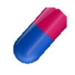
Dosage Invention
Even if a product and intended use thereof are known, if a remarkable effect can be obtained by the specific dosage regimen of the product, said dosage regimen is deemed as a patentable limitation.
What is known ?
What is claimed ?
Vitamin C for anti-cancer
administered twice a day is known
Anti-cancer drug comprising vitamin C which is administered 10-30mg once every two weeks.
2 weeks
10-30 mg

Slide 7
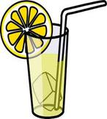

Food Invention
Functional foods, Fortified foods, Supplements = Specific use limitation
When a claim for foods/drinks has a limitation of an intended use, the intended use is considered as a claim limitation except for plants or animals per se.
Allowable Claim
- Anti-oxidant agent containing lemon. - A composition comprising a lemon extract. - Lemonade for anti-oxidant comprising 100 to 200 mg of vitamin C.
Unallowable Claim
- Lemon comprising 100 to 200 mg of vitamin C. - Lemon for anti-oxidant.

Slide 8
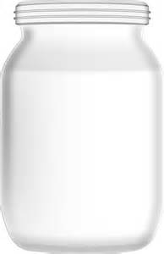
Combination Drug
What is known ?
What is claimed ?
Compound X is effective to treat lung cancer.
[1]
Medicament for treating lung cancer, comprising Compound X and vitamin C.
X, C
The effect of vitamin C in relation to Compound X is not known.
[2]
Enhancer for treating lung cancer using Compound X, in which said enhancer comprises vitamin C.
C
Remarkable effect of combination X and C is found.
Selling vitamin C alone may also infringe the claimed patent.

Slide 9
Use Claim Strategies for Japan (Litigation)
(Focusing on court cases of Use Claim)
1. “Novelty” and “Inventive Step”
2. “Technical Scope” of an Invention
3. Scope of “Injunctive Relief“
4. “Interpretation of “Swiss-type claim”
5. Claims including “effects” of the invention
Nakamura & Partners
Hideki Takaishi
Japanese Attorney at Law

Slide 10
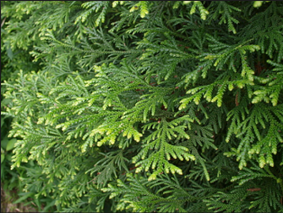
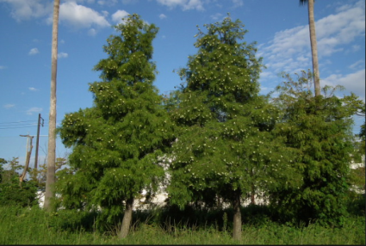

1. “Novelty” and “Inventive Step”
IP High Court (2006/11/29) 2009(Gyo-ke)10227
<Novelty >
In Japan, even if a claimed compound is identical with a prior art, the claimed invention comprising new “Use” has “Novelty.”
(=The claimed invention is different from the prior art.)
Prior Art
Extract from thujopsis as “whitening cosmetic”
<Thujopsis>
Evergreen tree
Claimed Invention
Court admitted “Novelty.”
=They are different inventions.
Extract from thujopsis as “wrinkle formation inhibitor”
http://www.publicdomainpictures.net/pictures/80000/velka/hand-cream-clip-art.jpg
http://conifersociety.org/wp-content/uploads/Thujopsis_dolabrata_Luteajpg.jpg

Slide 11
1. “Novelty” and “Inventive Step”
IP High Court (2006/11/29) 2009(Gyo-ke)10227
< Inventive Step >
(Same case as previous one)
In Japan, an invention is invalid based on lack of “inventive step,” if a person skilled in the art easily arrives at the claimed new “Use” from prior arts.
Prior Art
Claimed Invention
Extract from thujopsis as “whitening cosmetic”
Extract from thujopsis as “wrinkle formation inhibitor”
Court admitted “Inventive Step.”
Reason 1: Phenomenon of “wrinkles” and “blackening” are different.
Reason 2: Mechanisms of “wrinkles” and “blackening” are different.
Reason 3: There exist many different inhibitions and treatments.
Reason 4: A cosmetic catalog classifies that they are different products.

Slide 12
2. “Technical Scope” of Invention
Making or supplying a generic product is infringement when it is made or supplied for the patented (claimed) use.
⇒ Because if a certain act is found infringing regardless of its use, this would be virtually equivalent to a situation where there is a patent on the relevant substance (compound) itself.
⇒ When does the Court find that the accused product is made or supplied for patented use?
⇒ Typical case (page 5)
⇒ Another case (page 6)
⇒ Hypothetical case (page 7)

Slide 13
2. “Technical Scope” of Invention
Tokyo District Court(1992/10/23)1990(Wa)12094
<Typical case (package insert refers to patented use)>
If a generic product is approved (by the Ministry of Health, Labour and Welfare of Japan) for a use that falls within the claims of a patent and its package insert refers to such use, the generic product is an infringing product that is made or supplied for such use.
Claimed Invention
= Medicament comprising ketotifen for preventing allergic asthma.
The accused product 1
= Medicament comprising ketotifen for preventing allergic asthma.
The accused product 2
= Medicament comprising ketotifen for treating allergic asthma.
(Same case as page 9)
⇒ Infringing Use
⇒ NOT Infringing Use

Slide 14
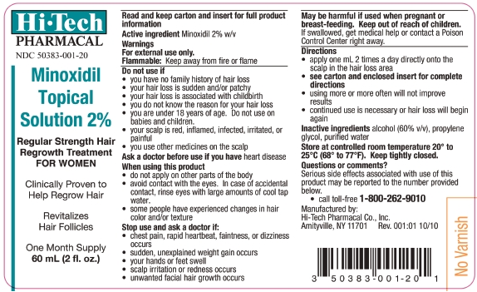
2. “Technical Scope” of Invention
Claim 1A: Medicament comprising Minoxidil for “hair regrowth treatment”
Claim 1 B: Medicament comprising Minoxidil for “vasodilator”
Claim 2A: Medicament comprising Minoxidil for “hair regrowth treatment”
to be applied “1ml / 2 times a day / onto the scalp”
Claim 2B: Medicament comprising Minoxidil for “hair regrowth treatment”
to be applied “via oral administration”
Claim 1A & 2B ⇒ Infringing Use
Claim 1B & 2B ⇒ NOT Infringing
Use
Example of
“package insert” and
its “reference of use”
http://www.iodine.com/drug/rogaine/fda-package-insert
https://en.wikipedia.org/wiki/Vitamin_C
http://free-photos-ls01.gatag.net/

Slide 15
2. “Technical Scope” of Invention
IP High Court (2006/11/21) 2005 (Ne) 10125
<Another case (not referring to patented use)>
Even though a generic product’s package insert does not refer to patented (claimed) use, the Court finds infringement if a patentee proves that it is made or supplied for such use based on facts.
Claimed Invention= Medicament comprising cilostazol as an
agent for “suppressing the thickening of vessel wall intima.”
The generic product comprised cilostazole and it’s package insert referred to another use; however, an infringer (maker of medicine) was actively promoting that the generic product had the same effects of the patented invention(=suppressing the thickening of vessel wall intima). ⇒ Court admitted infringement.

Slide 16
2. “Technical Scope” of Invention
<Hypothetical case (without acts by an infringer)>
※Report of Japan Team (AIPPI Q238) (AIPPI Journal, July 2014, p212-228)
So far, there is no court case in Japan where the court admitted that a product is made or supplied for patented use without acts by an infringer.
ex.) promoting that it has the effect of the patented (claimed) use.
⇒It is possible, for example, if it is known among medical doctors that the generic product is in high demand for the patented use, the patentee may be able to prove that the generic product is made or supplied for the patented use.

Slide 17
3. “Parameter” as Use Claim
IP High Court (2014/12/24) 2014 (Gyo-ke) 10045
Prior Art = “Medicament comprising 4mg Zoledronic acid administered
to a patient’s vein (intraveneously) for less than 5 minutes”
Claimed Invention = “Medicament comprising 4mg Zoledronic acid administered
to a patient’s vein (intraveneously) for more than 15 minutes”
※The inventor found that 4mg Zoledronic needs to be administered slowly to avoid a hidden side effect which was not known at the filing date.
⇒Court admitted “Inventive Step.”
Reason 1: Zoledronic has high activity ⇒ small amount is enough
Reason 2: 15 minutes dose is inconvenient and a burden to patients
Reason 3: 5 minutes does was considered safe based on prior arts
⇒ A person skilled in the art did not have a motivation to extend the administering period from “less than 5 minutes” to “more than 15 minutes”.

Slide 18
4. Interpretation of “Swiss-type claim”
< Swiss-type claim >
(Example) “Use of vitamin C for preparing anticancer drug”
Under the Japanese Patent Act (Article 2-3),
・An invention of simple a process covers only “using” the process.
・An invention of a process for producing a product covers not only “using” the process but also “using, assigning, exporting, importing or offering for assignment” the product produced by the process.
(※No court case in Japan, so far.)
※Japan Patent Office officially states their opinion that a swiss-type claim is “invention of simple a process.”
⇒If so, a patentee of swiss-type claims cannot obtain an injunction against defendant’s assigning the product.
⇒ Swiss-type claims are less useful in Japan.

Slide 19
5. Claims including “effects” of the invention
IP High Court (2014/9/10) 2013 (Gyo-ke) 10209
※Claiming not only “use” but also “effect(s)” is useful in the admission of “Inventive Step.”
Claimed Invention = “Medicament comprising IleProPro… as an active ingredient
having effects of … suppressing the thickening of vessel wall intima”
⇒Court admitted “Inventive Step” based on the claimed “effect.”
Since under the technological level at the application date,
a person skilled in the art did not assume without experimentation whether each ACE inhibitor actually has such an effect.
Prior Art = “Medicament comprising IleProPro… as an active ingredient”
≠ Invention = “Medicament comprising IleProPro… as an active ingredient having the effect of … suppressing the thickening of vessel wall intima”

Slide 20
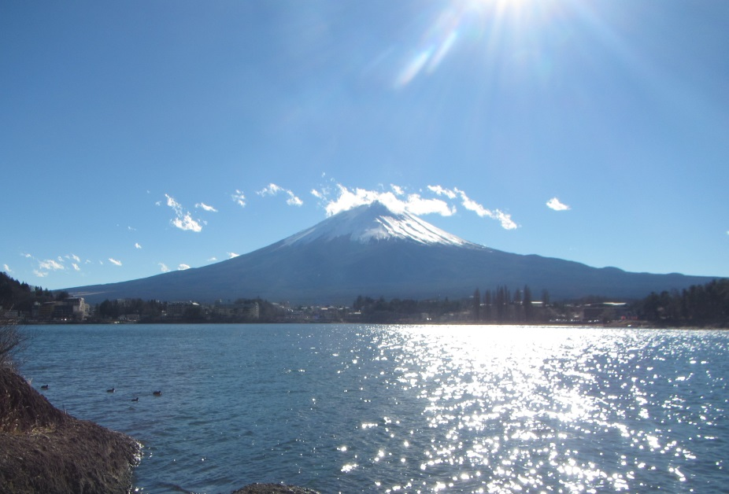


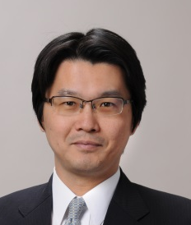
Questions ?
NAKAMURA & PARTNERS
3-3-1 Marunouchi Chiyoda-ku Tokyo, JAPAN
Hironobu Hattori h_hattori@nakapat.gr.jp
NAKAMURA & PARTNERS
3-3-1 Marunouchi Chiyoda-ku Tokyo, JAPAN
Hideki Takaishi h_takaishi@nakapat.gr.jp

